Slide 1
CKEY Authentication 25.7

Slide 2
Presentation key points
US’s: [ACMTDEV-325-326-327]
Remote branch on gitlab: feature/ACMTDEV-325-keycloak-implementation merge to develop
  Set up Spotlab and run the ncmt_install.sh file
  reproduce login, logout, notification modal to refresh session
  Describe SPA OIDC authentication code flow
  Run and describe tests if need it
Documentations on Confluence Page
  SPOG host Application, Keycloak Service
  Topology MFE Keycloak Service

Slide 3
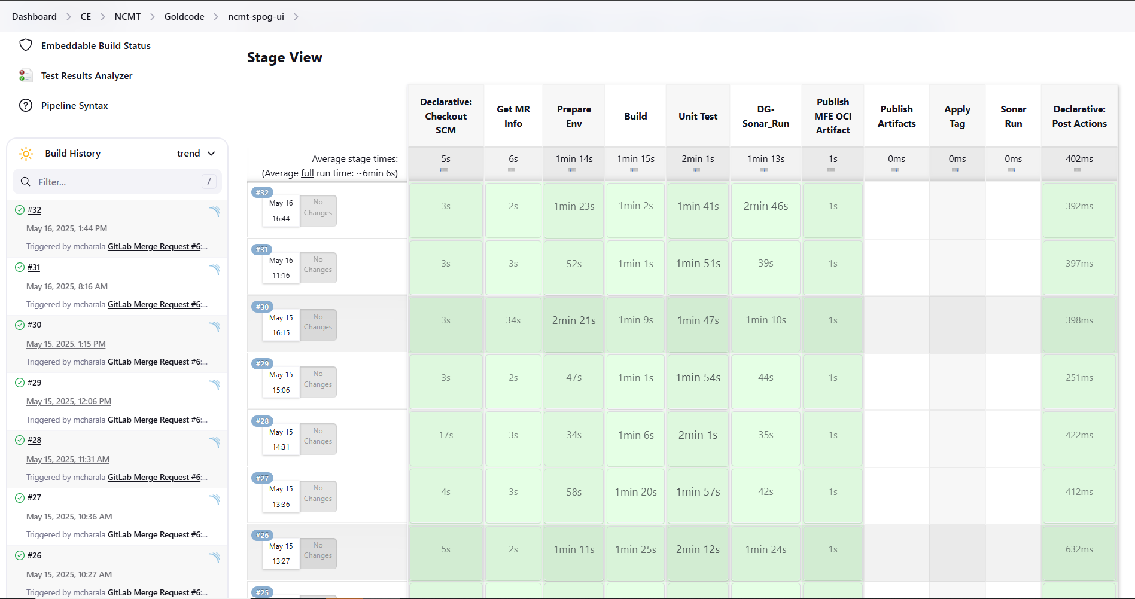
Jenkins Pipeline

Slide 4
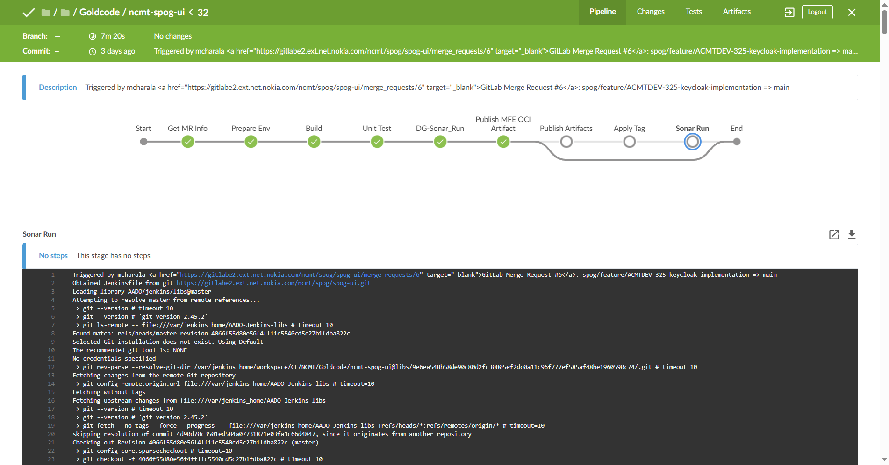
Jenkins Pipeline

Slide 5
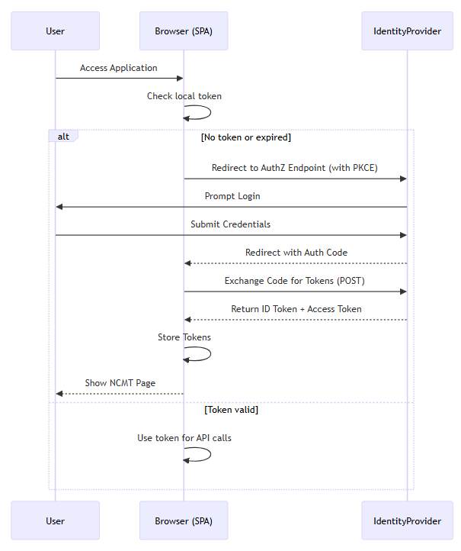
SPA OIDC Authentication Flow

Slide 6
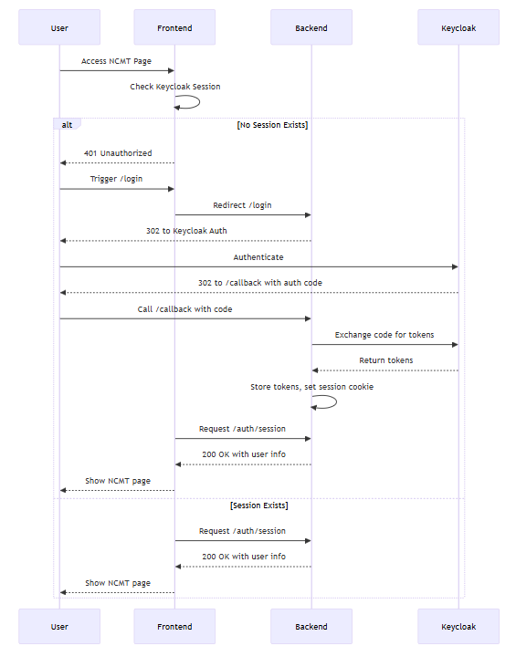
OIDC Authentication Flow with AS

Slide 7
SPA OIDC Authentication Workflow
OIDC authentication flow for Single Page Application (SPA) using Keycloak, authenticates users (on web applications) by redirecting them to the OIDC provider (like Keycloak, Google or Auth0), where they authenticate, and then exchanging an authorization code for an access token and ID token on the client-side. This flow has security risks by keeping sensitive information like tokens on the client-side and allowing the front-end to manage access to protected resources by sending tokens in each request to the backend.
Backend oidc authentication code flow
Authentication Service (AS)
The OpenID Connect (OIDC) Authorization Code Flow with backend authentication service securely authenticates users (on web applications) by redirecting them to the OIDC provider (like Keycloak, Google or Auth0), where they authenticate, and then exchanging an authorization code for an access token and ID token on the server-side. This flow enhances security by keeping sensitive information like tokens off the client-side and allowing the backend to manage access to protected resources.

